Slide 1
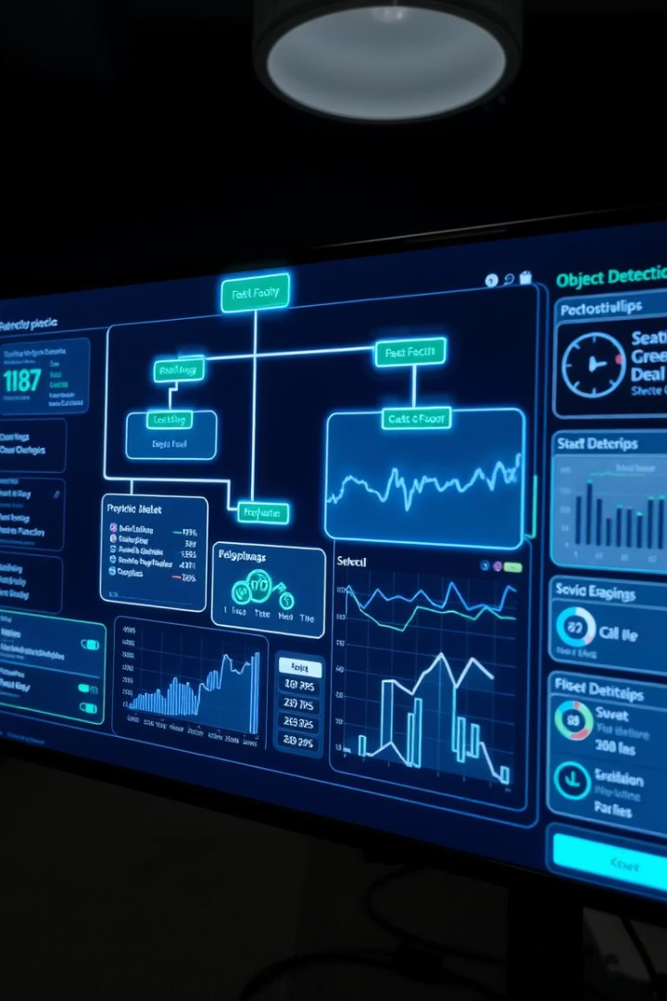
Hierarchical Sub-Object Detector
By:-
Jay Dev
Himanshi Singh
Kunal Kumar
Sumit Kumar

Slide 2

Problem Statement
Real-time systems miss sub-objects
Critical in multiple domains
Helmet, face mask, machine parts often undetected
Surveillance, quality assurance, healthcare

Slide 3
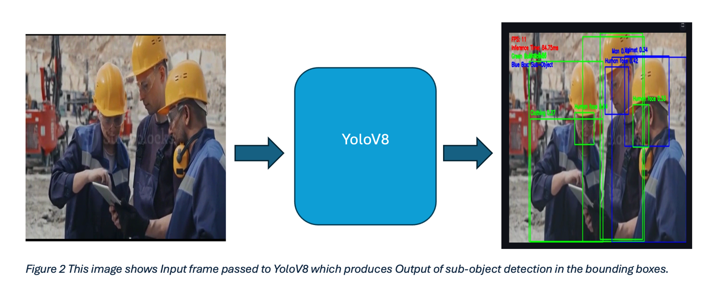
Objective
Detect main and sub-objects live
Output structured JSON
Crop detected objects for analysis
Run at 10–30 FPS on CPU

Slide 4
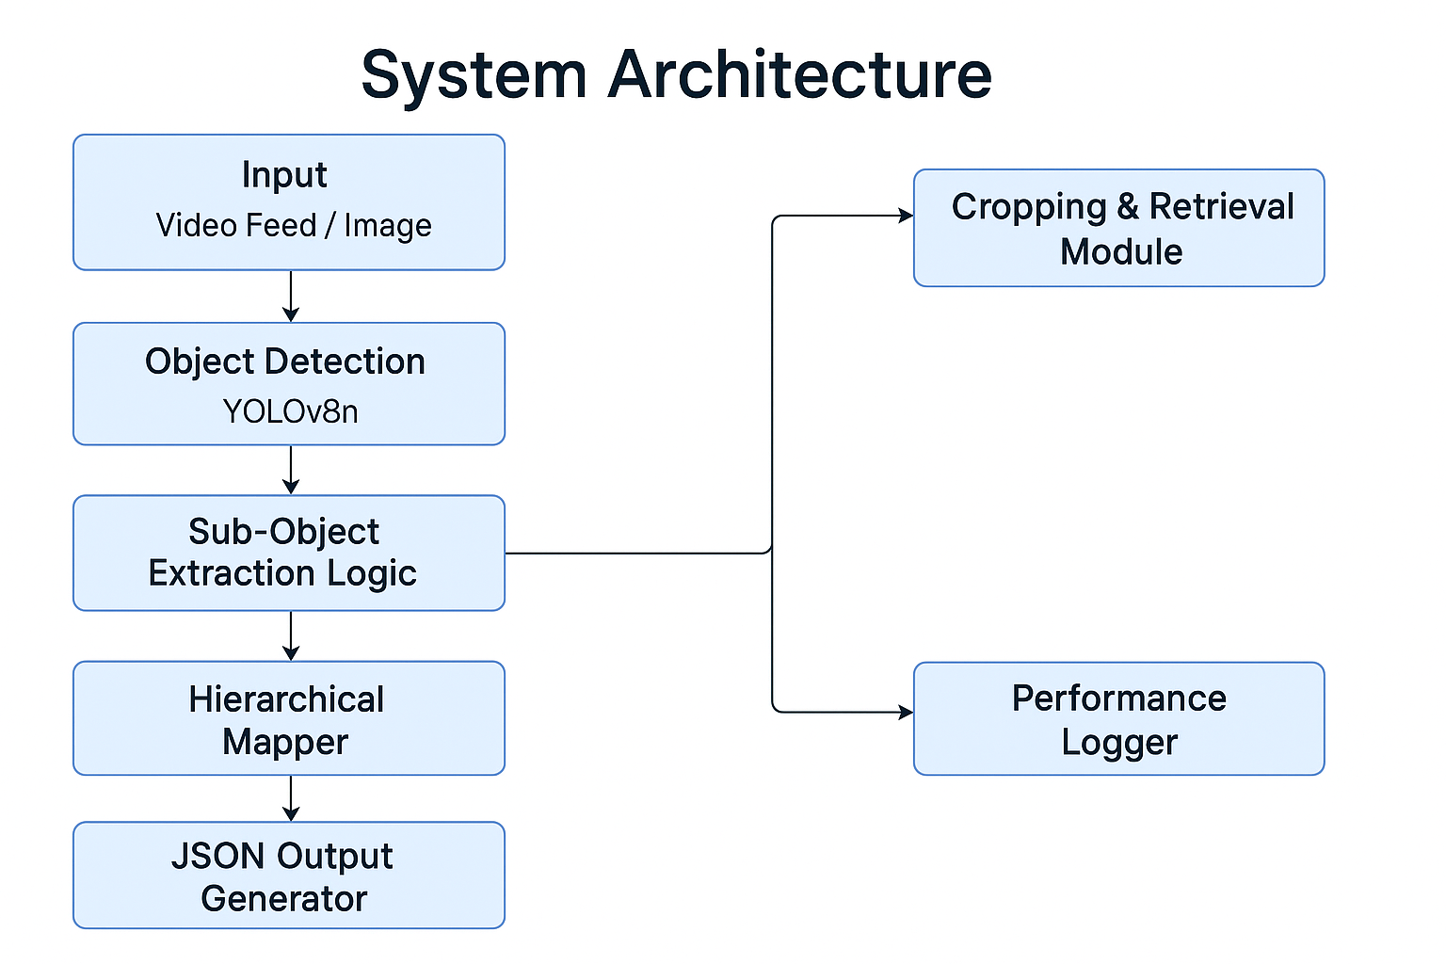

Slide 5
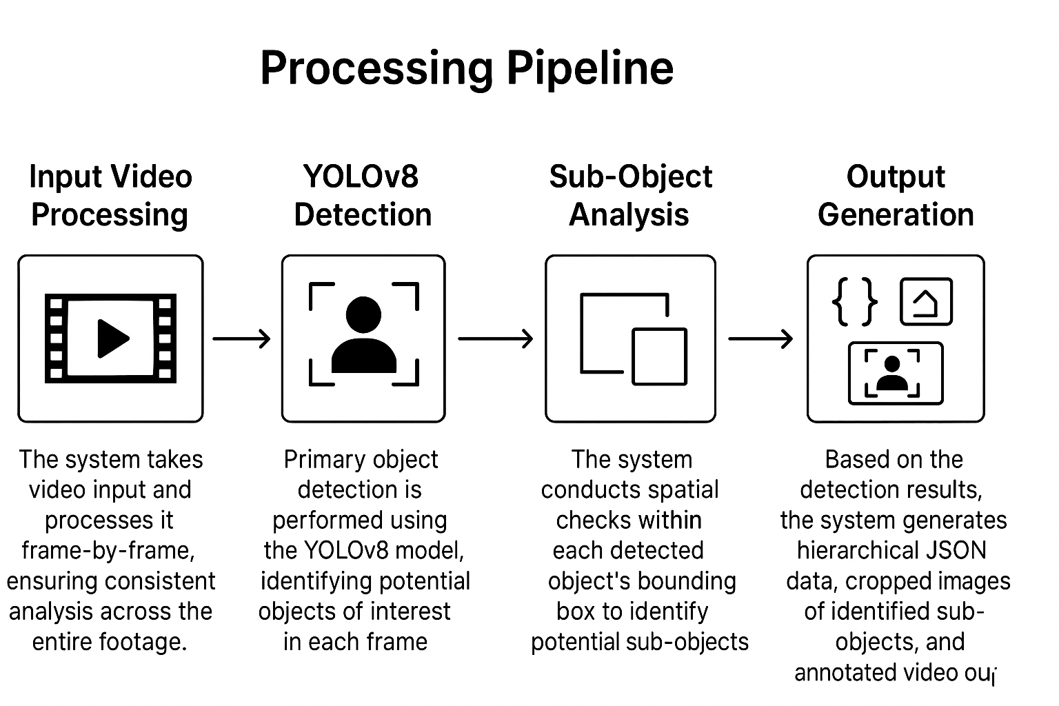
Detection Pipeline

Slide 6

Performance
FPS
10–30 frames per second on CPU
Model Size
~3MB lightweight YOLOv8n
Example
15 FPS on Intel i7 processor

Slide 7
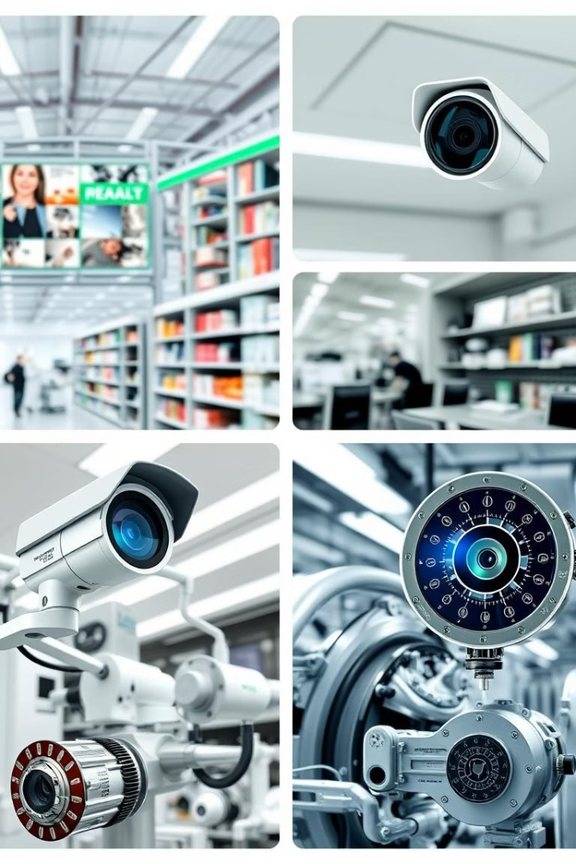




Applications
Quality Assurance
Security Surveillance
Healthcare Monitoring
Retail Analytics

Slide 8
Challenges & Future Work
Challenges
Future Work
Overlap handling: boundary logic
Integrate object tracking
Speed: lightweight model optimization
Use transformers for sub-object detection
Implement feedback loop improvements

Slide 9

Cropping Feature
Crop and save sub-objects
Stream cropped images
Facilitates detailed analytics

Slide 10
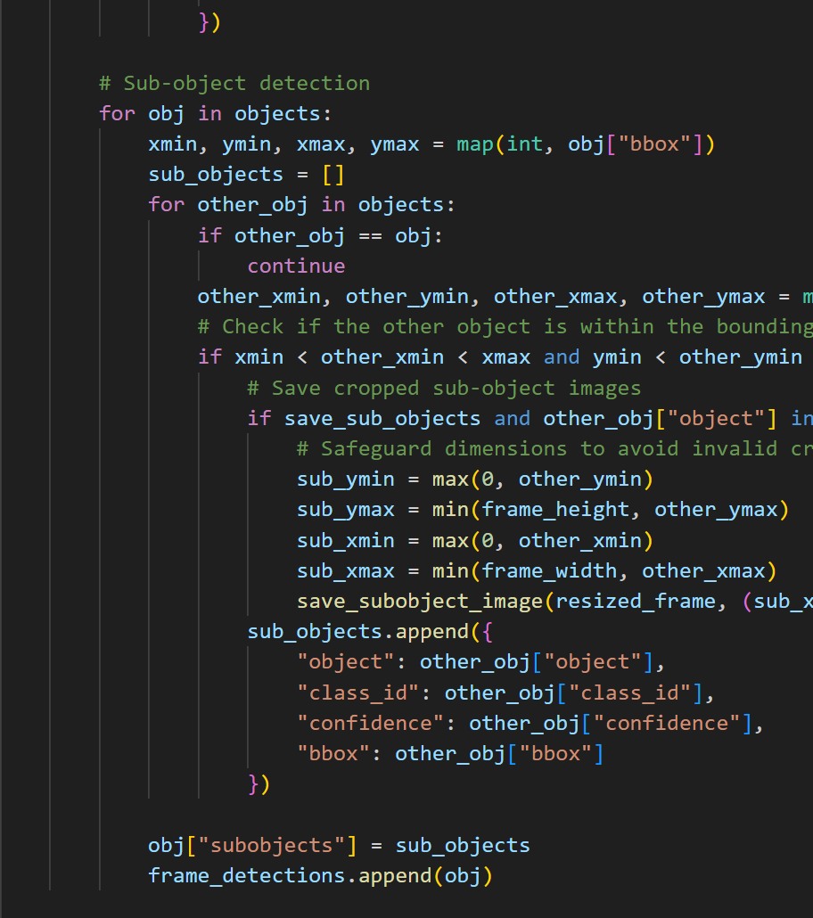
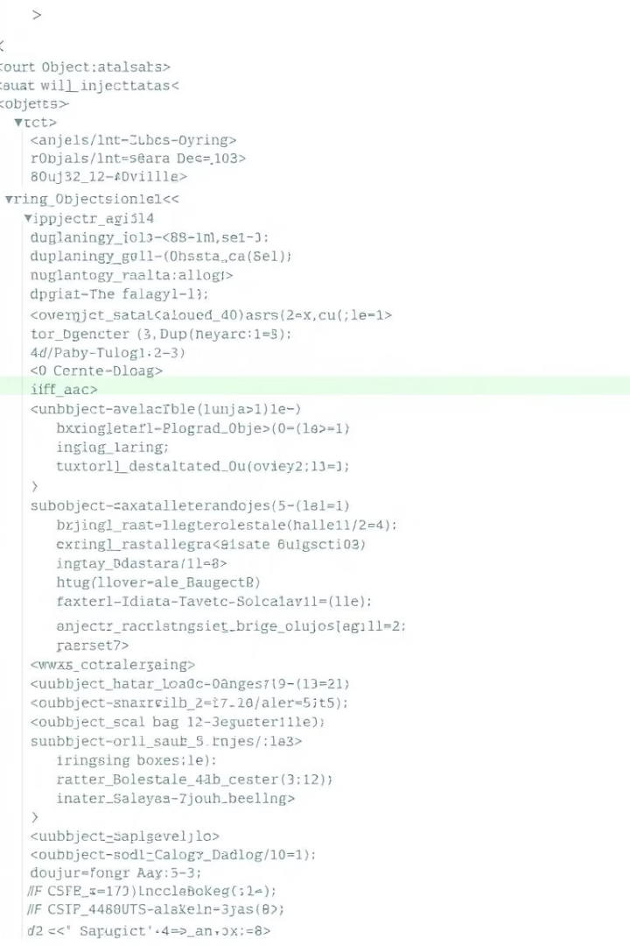
Sample JSON Output
{
"object": “Car",
"bbox": [100, 150, 200, 250],
"sub_objects": [
{"name": “person", "bbox": [120, 170, 140, 190]},
{"name": “License Plate", "bbox": [180, 210, 190, 220]}
] }

Slide 11
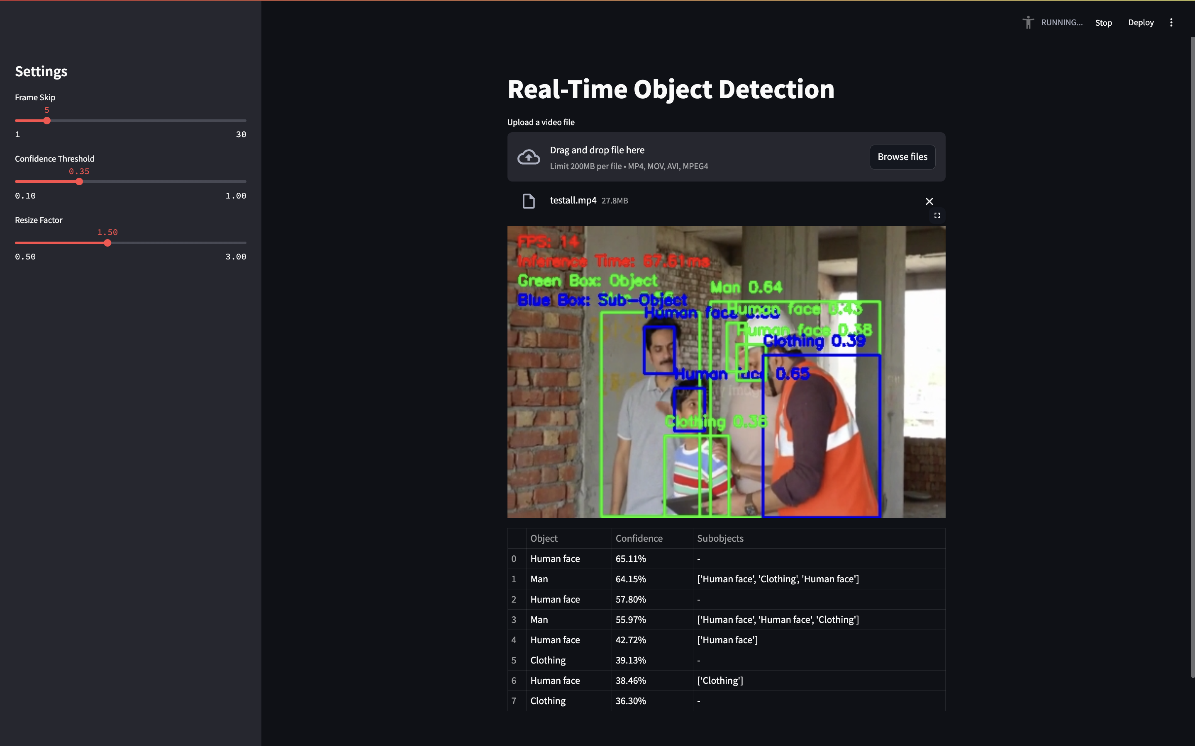
Demo / Screenshot

Slide 12
Conclusion
First real-time CPU-capable detector with hierarchical sub-object structure
Designed for impact, efficiency, and scalability.

Slide 13
Thank you! Happy to take questions.

